Slide 1


Artificial Intelligence Knowledge System

Slide 2

Problem 1: Information Overload
Can you please give me what I need?!!!
Too much data, documents, information.
And most of them are useless to me.

Slide 3
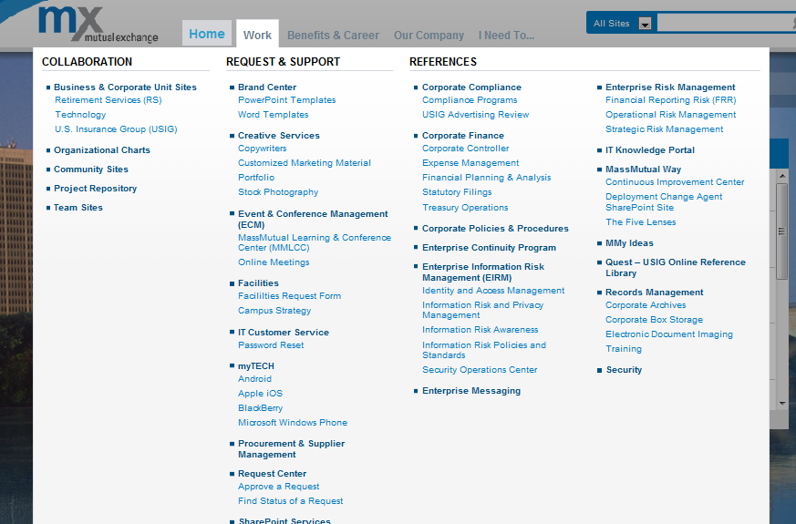
Problem 2: Findability
Too many clicks before get to any target. Cumbersome user experience.

Slide 4
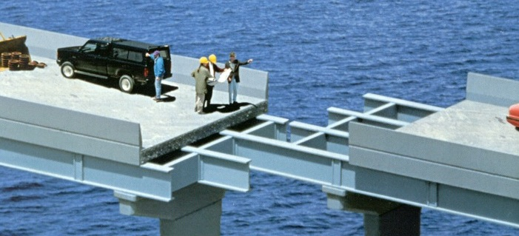
Problem 3: No real-time, unbiased project feedback

Slide 5
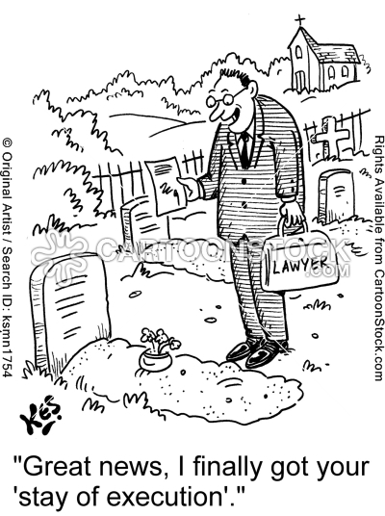
Problem 4: no real time role feedback

Slide 6
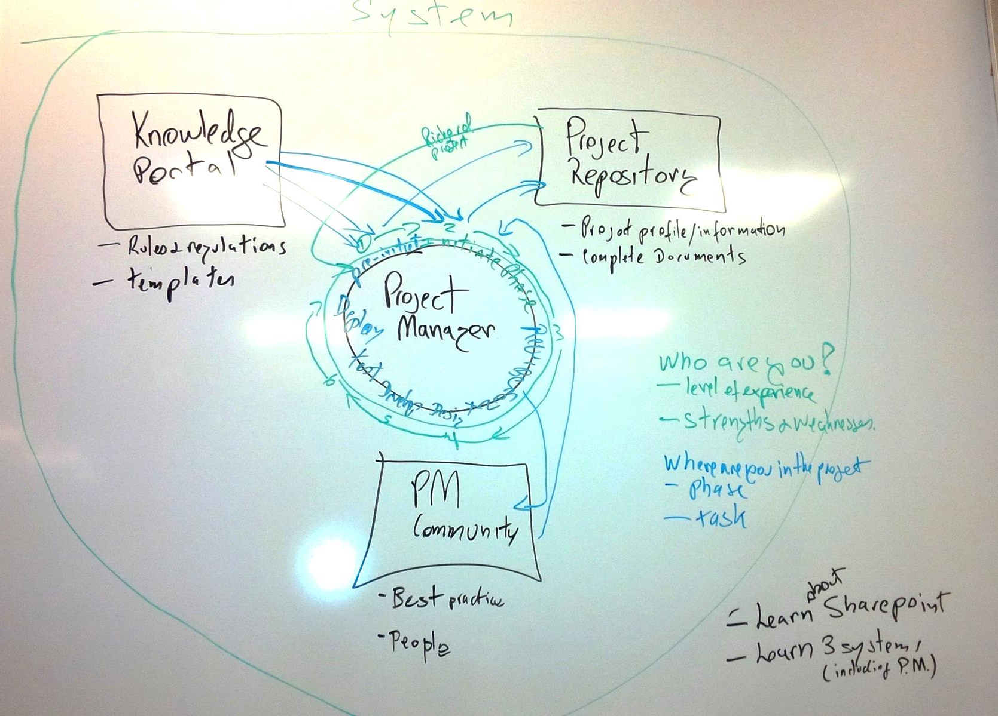
Case Study

Slide 7
Research Method
Preparation
Clean raw project and individual data, build database
Create a profile for each team member
Combine visit patterns with the probability of success of project using Statistical Methods
Analysis
Identify leading indicators of unsuccessful projects
Identify leading indicators of successful projects
Detect problem areas for team members
Action
Build machine learning system through indicators
Leverage artificial intelligence methods to provide project and role alerts
Leverage artificial intelligence methods to present relevant knowledge
Notes:
Leading indicators are
Machine learning, a branch of artificial intelligence, concerns the construction and study of systems that can learn from data.

Slide 8





Our design
My Project
PR, KP, Communities
Knowledge System
Project Team Members
Project Team Members
Notes:
Goal: Give People the information they need

Slide 9
Data sources
Project
Project Repository Visit History
Knowledge Portal Visit History
Team Members’ Name and Role
Email Communications
Version history of documents
Notes:
Two central nodes:
- Project
- individual

Slide 10
Project Intelligence
Inputs
Team member role baselines
Team member participation levels
Team member visitation patterns
Team member profile
Network analysis (email)
Project attributes
Triggers
Spike/Drop events
Role base-pattern variance

Slide 11
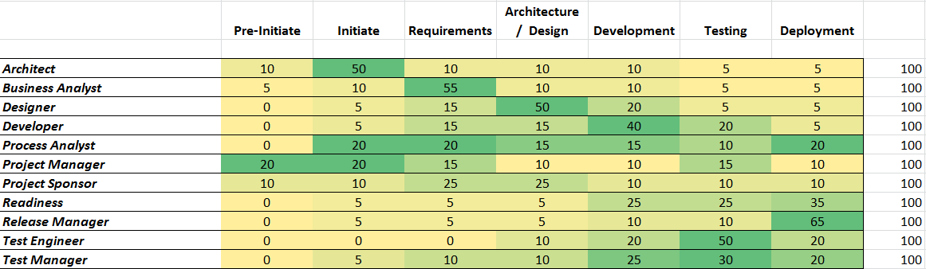
Models
Hypothesis: Visitation patterns matching this model will lead to success

Slide 12
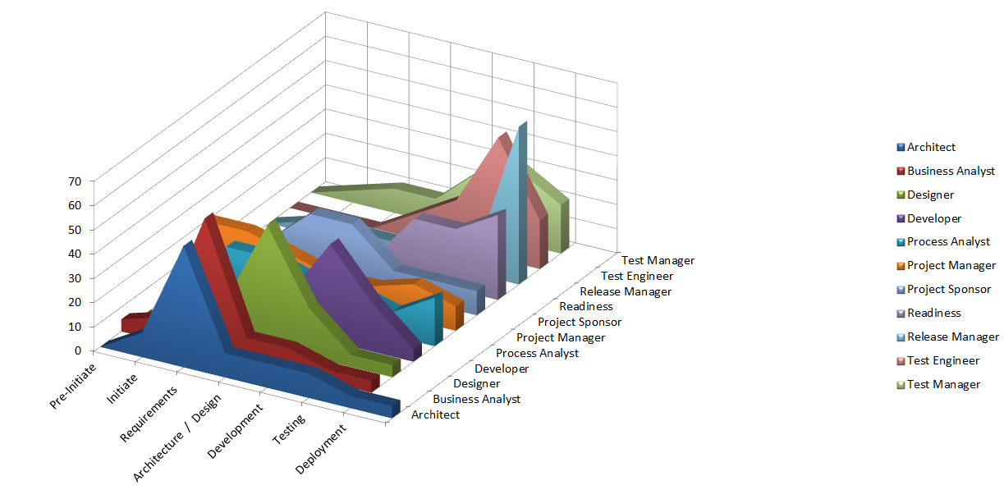
Models

Slide 13
Ethnography
Interview project managers and team members
Identify perceived challenges
Explain anomalies

Slide 14
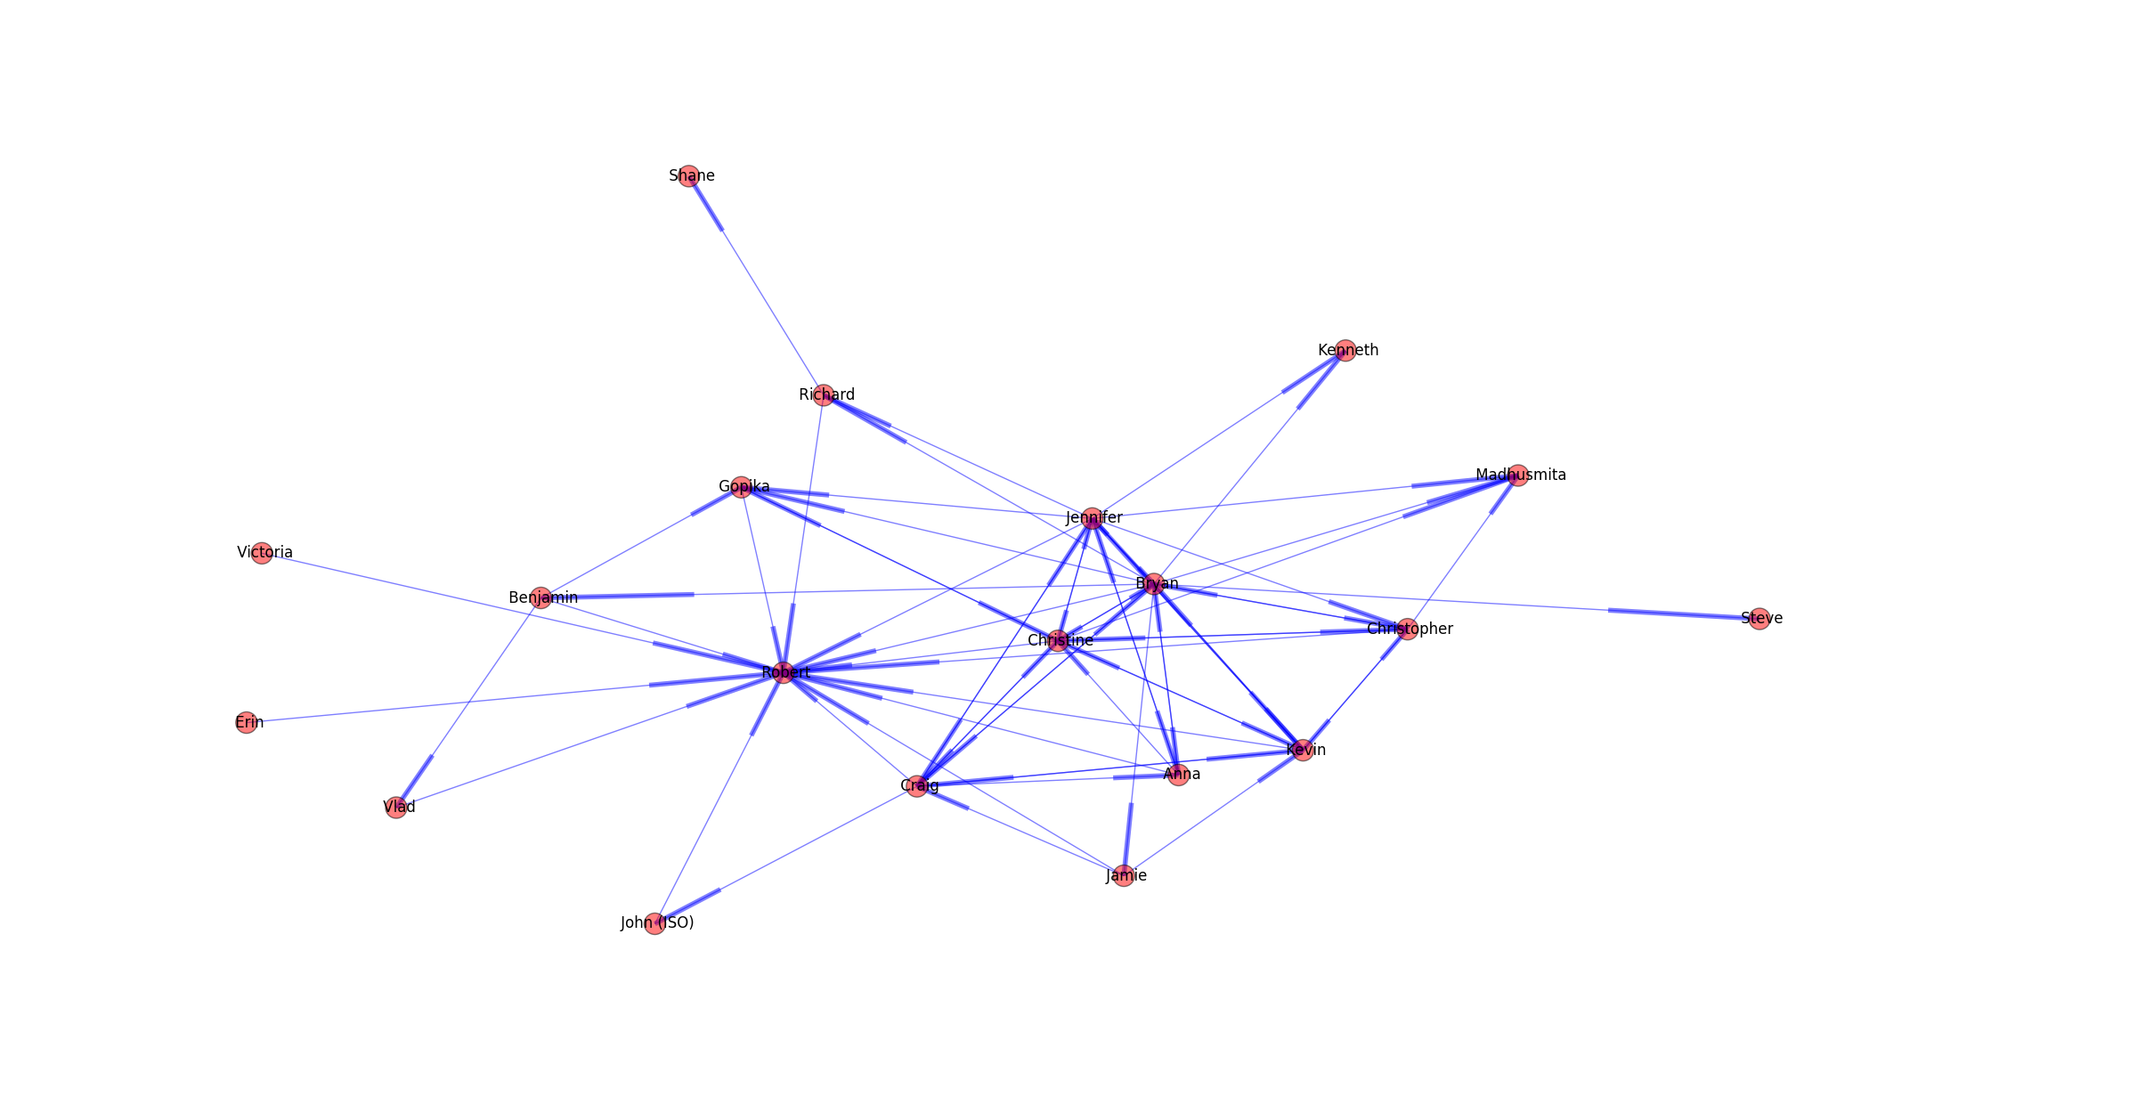
Data and Analysis
Robert Email Social Network Analysis
Data Observed | Hypothesis
Weak/Distant Nodes | Expected: low base-pattern interaction levels Unexpected: poor communication

Slide 15
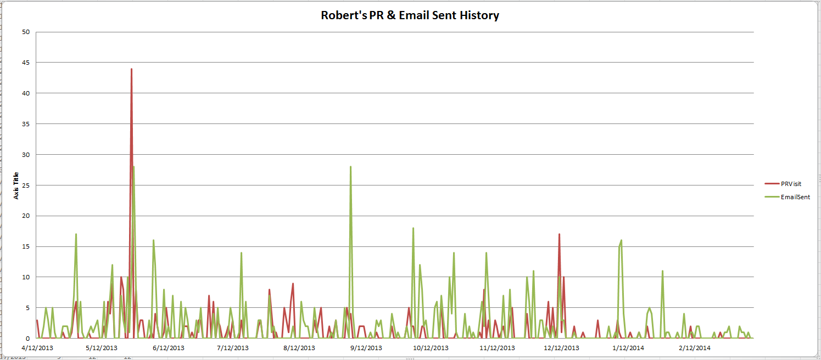
Data and Analysis
Data Observed | Hypothesis
Sudden spikes | Expected: major efforts Unexpected: emergencies
Sudden drop | Expected: vacation, phase changes Unexpected: problem with the project

Slide 16
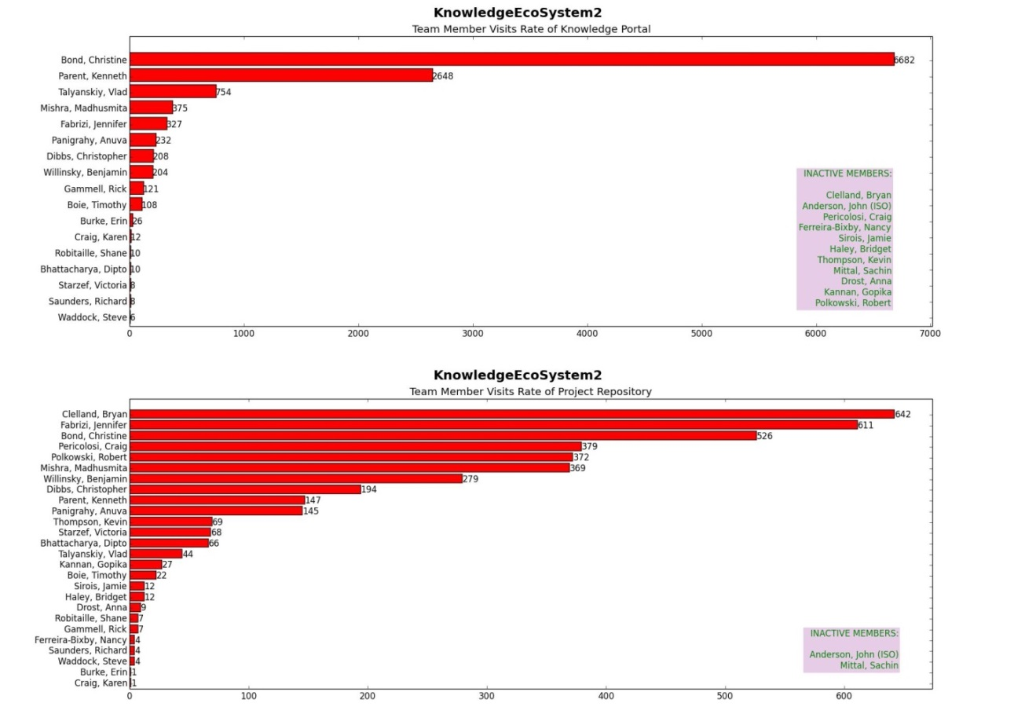
Data and Analysis
Data Observed | Hypothesis
Low or nil KP and PR visits | Expected: low base-pattern level of involvement Unexpected: poor quality work
High PR and Low KP | Expected: high base-pattern level of involvement Unexpected: high quality deliverables

Slide 17
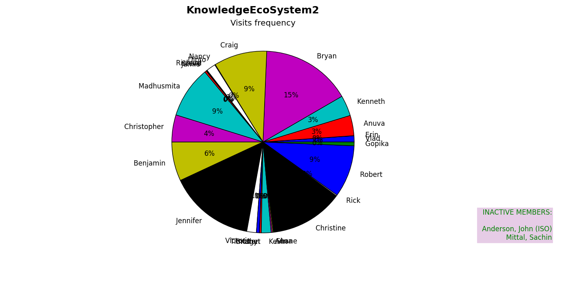
Data and Analysis
Data observed | Hypothesis
PM visit percentage 15% | Successful PMs show a consistent level of involvement

Slide 18
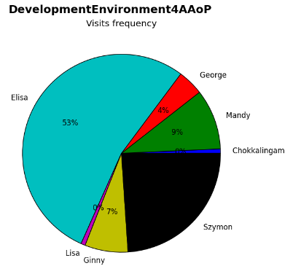
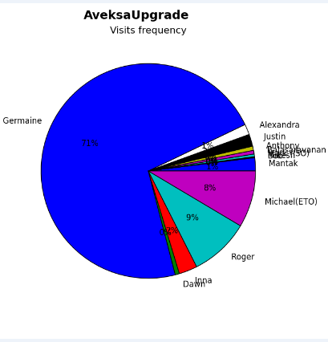
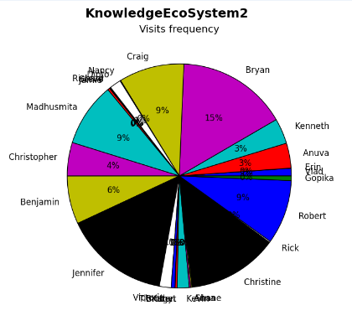
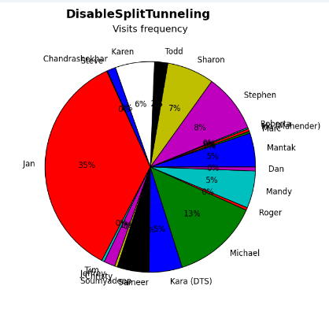
Elisa
Germaine
Data observed | Result
PM visit percentage >> 15% | Cancelled Projects
Bryan
Michael
Data observed | Hypothesis
PM visit percentage ~15% | Successful projects

Slide 19
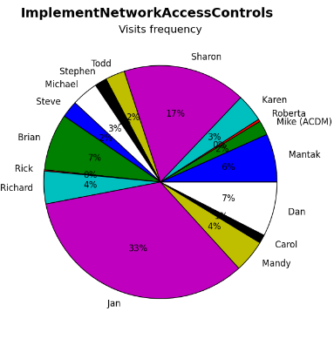
3: PM with a low PR visitation rate – methodology mismatch
Richard

Slide 20
What is Artificial Intelligence?
AI is "the study and design of intelligent agents" where an intelligent agent is a system that perceives its environment and takes actions which maximizes its chances of success”
Machine learning is a branch of artificial intelligence concerned with the construction and study of systems that can learn from data.

Slide 21
AI in Knowledge Ecosystem
Information overload
Information findability
Real time project feedback
Real time role feedback

Slide 22
demo
Notes:
Robert Data → Artificial Intelligence identify weakness → outputs (risk, expertise, warnings, information/suggestion)
Project Data → Artificial Intelligence identify weakness → outputs (risk, expertise, warnings, information/suggestion)
Components:
*SQL Databases (to be automated on long run)
*?Python language (to clean and prepare data)?
*Algorithm (in any language)
To build Robert SQL Database, write code to:
1) scan robert activities
2) record activities in database
To analyze, build code to
1) scan database to find Robert’s weaknesses
2) scan project database to find project weaknesses
3)
To make recommendations for success, build code to
1) query all employee databases and identify talent (expert person) to help
2) query all knowledge databases and identify relevant knowledge/information/best practices/tools
3) “present” recommendation to consult with expert person
4) “present” recommendation to consult relevant knowledge/information/best practices/tools

Slide 23


Future Plan – Technical
Build database for each IT employee
Use AI to recognize each employee
Work experience
Technique expertise score
Practice expertise score
Works habits
Project history

Slide 24
Future Plan – Technical
Enhance PR SQL Database to capture necessary project inputs
Create code to analyze individual node and project node (PR)
Knowledge Ecosystem front end to deliver relevant knowledge, information, alerts, tools

Slide 25
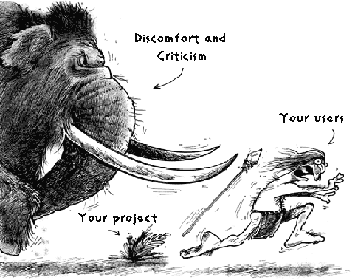
Future Plan - Practice
Standards to rate project success
Standards to rate individual performance
?

Slide 26
Recommendations
Build personal database (immediately, co-op + Springfield/Amit)
Enhance PR (KE3)
Build model for similar projects (document elements, project attribute classification)
Create Artificial Intelligence code (Northeastern Co-Op)

